Slide 1
IBM’s Banking Industry Models – Introduction
Banking Process, Service and Data Models

Slide 2
Disclaimer Notice
Licensed Materials - Property of IBM
© Copyright IBM Corp. 2013. All Rights Reserved.
MATERIAL RESTRICTED TO LICENSED CUSTOMERS ONLY - DO NOT DISTRIBUTE
Employee Personal Use and Education: You may download this material for your own personal use and education in support of IBM's business. You may not (a) transfer any material downloaded for these purposes to any external customer or any other employee or (b) use it in support of your own business outside of IBM.

Slide 3
Agenda
Learn about the models and banking content supported
Learn about the model development options
Learn about each of the model components
  Development options for m1
  Development options for Standard Tooling
Learn about how models support a project development lifecycle
Summary

Slide 4

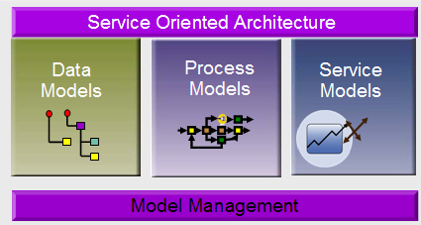
What are the Data, Process & Service Models?
  Business and IT accelerators that provide an integrated analysis and design development approach across the enterprise
  Supports retail, corporate, private banking, financial markets and the insurance sector
  Developed using standard terminology to identify and reduce confusion between business and IT
  Agile and flexible solutions that can be easily extended based on customer, regulatory and industry standard specifications
  Improve business requirements gathering to shorten project timelines and reduce rework
  Phased project deliverables offer focused & more efficient project solutions
Proven Approach and Methodology
Embedded Industry Expertise
More than 500 global clients

Slide 5
Value Proposition Industry Models
Key Capabilities
IBM Industry
Foundation Models
Models used provides a structured data dictionary that defines the business terms and phrases used within a given industry
Foundation
Models
Open platform
Industry expertise
Business structured
Easily customized
Standards compliant
Integrated tooling
Process
Models
Service
Models
Data
Models
IBM Industry
Process Models
Process Models provide pre-defined analysis-level processes, used to ensure consistency and reuse of processes and activities
Key Value Propositions
IBM Industry
Service Models
Enables business users to easily scope and customize their own requirements
Facilitates step-by-step business focused development and roll-out
Delivers regularly updated business, technical and regulatory content
Creates open technology platform for any application or integration solution
Manages definitions and standards in complex IT environments
Service Models provide the pre-defined analysis and design level structures to enable more consistency and reuse in the creation of Services
IBM Industry
Data Models
Data Models provide the pre-defined analysis and design level structures to accelerate DW and BI deployments

Slide 6
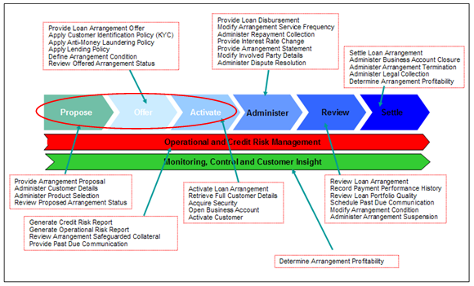
Banking Model Content – Example Coverage
Consumer Lending
HR Policies
Mortgages
Payments
Cash Management
Commercial Lending
Trade Finance
Savings, Investments and Deposits
Card Products Administration
Sales & Relationship Management
Regulatory & Compliance
Corporate Actions
Wealth Management
Best Execution / MiFID
Trade Processing
Product & Marketing Management
KYC/Account Opening
Asset & Liability Management

Slide 7
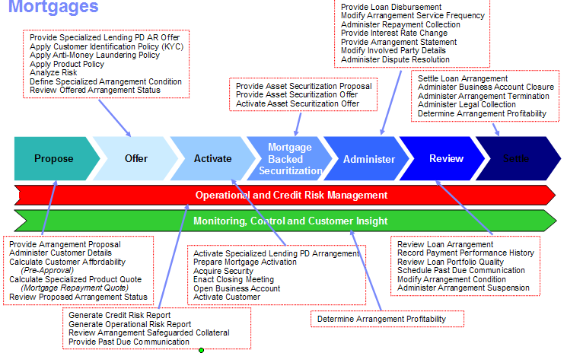
Banking Model Content – Example Coverage
Consumer Lending
HR Policies
Mortgages
Payments
Cash Management
Commercial Lending
Trade Finance
Savings, Investments and Deposits
Card Products Administration
Sales & Relationship Management
Regulatory & Compliance
Corporate Actions
Wealth Management
Best Execution / MiFID
Trade Processing
Product & Marketing Management
KYC/Account Opening
Asset & Liability Management

Slide 8
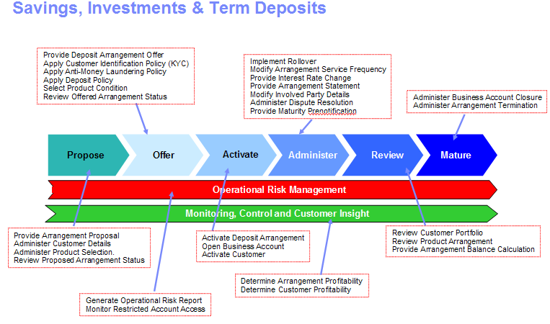
Banking Model Content – Example Coverage
Consumer Lending
HR Policies
Mortgages
Payments
Cash Management
Commercial Lending
Trade Finance
Savings, Investments and Deposits
Card Products Administration
Sales & Relationship Management
Regulatory & Compliance
Corporate Actions
Wealth Management
Best Execution / MiFID
Trade Processing
Product & Marketing Management
KYC/Account Opening
Asset & Liability Management

Slide 9
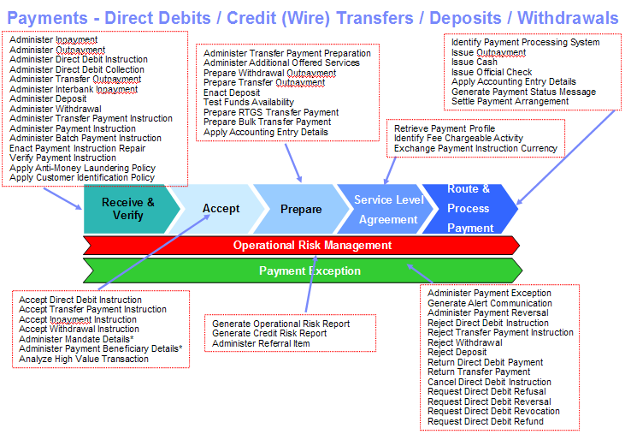
Banking Model Content – Example Coverage
Consumer Lending
HR Policies
Mortgages
Payments
Cash Management
Commercial Lending
Trade Finance
Savings, Investments and Deposits
Card Products Administration
Sales & Relationship Management
Regulatory & Compliance
Corporate Actions
Wealth Management
Best Execution / MiFID
Trade Processing
Product & Marketing Management
KYC/Account Opening
Asset & Liability Management

Slide 10
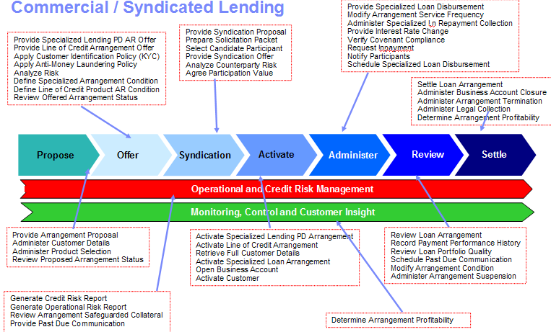
Banking Model Content – Example Coverage
Consumer Lending
HR Policies
Mortgages
Payments
Cash Management
Commercial Lending
Trade Finance
Savings, Investments and Deposits
Card Products Administration
Sales & Relationship Management
Regulatory & Compliance
Corporate Actions
Wealth Management
Best Execution / MiFID
Trade Processing
Product & Marketing Management
KYC/Account Opening
Asset & Liability Management

Slide 11
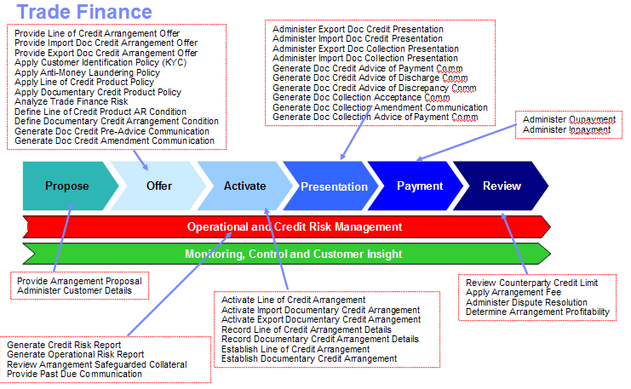
Banking Model Content – Example Coverage
Consumer Lending
HR Policies
Mortgages
Payments
Cash Management
Commercial Lending
Trade Finance
Savings, Investments and Deposits
Card Products Administration
Sales & Relationship Management
Regulatory & Compliance
Corporate Actions
Wealth Management
Best Execution / MiFID
Trade Processing
Product & Marketing Management
KYC/Account Opening
Asset & Liability Management

Slide 12
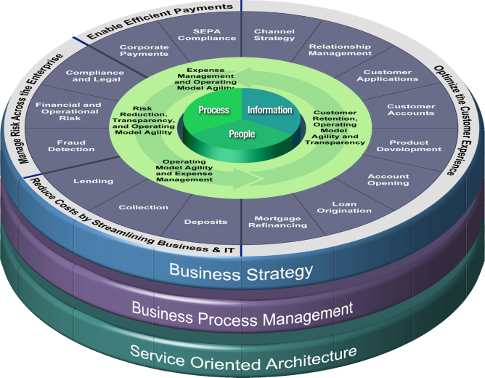

Banking Model Metrics
STRATEGY
501 business functions
202 business components
Process Models
535 business processes
2800 business activities
3200 business events
Service Models
600 Candidate Services
41 Components
348 Interfaces
4200 Operations
Improved efficiency and cost reduction
Improved customer experience
Improved regulatory compliance
Improved efficiency and cost reduction
BPM and SOA project accelerator
Agile & flexible models that are easily extendable

Slide 13
Agenda
Learn about the Models and banking content supported
Learn about the model development options
Learn about each of the model components
Learn about how models support a project development lifecycle
Summary
BPS for Standard Tooling

Slide 14

Banking Process & Service Models
Off-the-shelf Tooling
Vocabulary (IBG)
Business
Terms
Analytical
Requirements
Analysis
Process
Model
Business
Object
Model
Design
Model Datatypes
Orchestration
Process
Model
Interface
Design
Model
Service
Design
Model
Data Models (IDA)
Process Models (BPMN20)
Service & Component Models (RSA/SoaML)
Environment based solely on standard tooling
Option of Business content in IBG – partial integration to RSA
Full integration with RSA, BPM, (and broader WebSphere/Rational product suite)
SCM Integration (RSA)
Limited manual Scoping,
Model Management (via SCM)
BPS for Standard Tooling

Slide 15
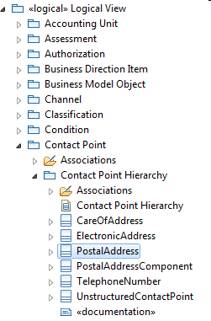
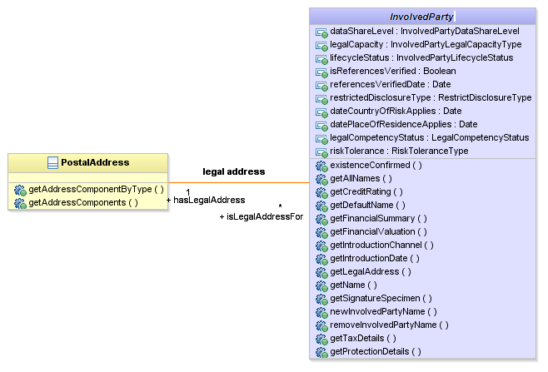
Business Object Model (BOM)
Analysis
Process
Model
Business
Object
Model
Orchestration
Process
Model
Service
Design
Model
Interface
Design
Model
The Service Models provide the pre-defined analysis and design level structures to enable more consistency and reuse in the creation of services.
Provides technology independent class models that enable traceability between automated business process requirements and downstream SOA IT analysis representation.
Facilitates the formal definition of candidate services as SoaML Capability operations and allows their mapping to the global task or process in the Analysis Process Model from which they were derived
Provides a detailed class model of concepts referenced by the capability operations. The class model contains classes, attributes, associations, primitive and enumerated types in order capture a data structure that supports the information requirements of capability operations
BPS for Standard Tooling

Slide 16
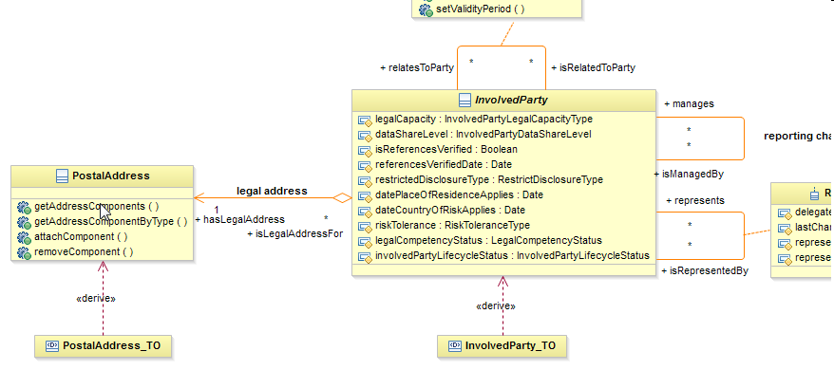
Interface Design Model (IDM)
Analysis
Process
Model
Business
Object
Model
Orchestration
Process
Model
Service
Design
Model
Interface
Design
Model
Provides a design for the development of components, types, interfaces, and data transfer objects for an enterprise-wide business services based architecture.
The IDM contains a class model derived from the analysis class model in BOM, which contains the elements that support the services defined in the Design models
The IDM is used to formally define the fine grained, intermediate level services, that interact with the UML class model elements
Transfer Objects are defined and maintained in the IDM. New Transfer Objects can be created and existing Transfer Objects can be customized according to the data requirements of the consuming service
BPS for Standard Tooling

Slide 17
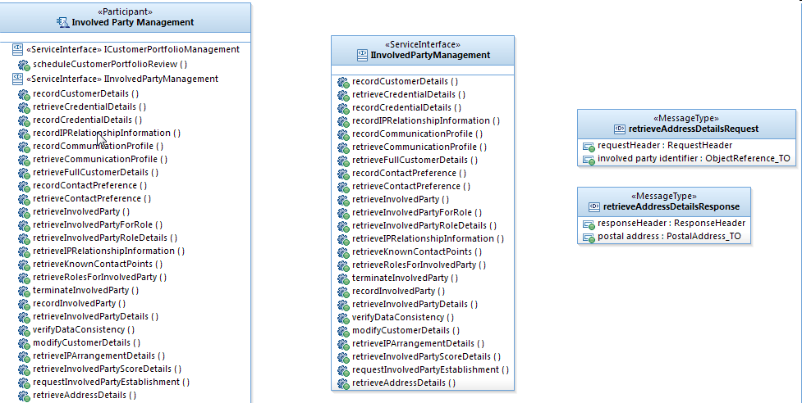
Service Design Model (SDM)
Service Design Model only available with the “off the shelf” tooling option
Analysis
Process
Model
Business
Object
Model
Orchestration
Process
Model
Service
Design
Model
Interface
Design
Model
Provides a design for the development of participants, service interfaces, and messages appropriate for an enterprise-wide business services based architecture.
Facilitates the formal definition of SoaML Participants and the Services they provide based on the SoaML Capability operations identified in the BOM
These participant components and their services are focused at a coarse-grained business or transactional level
The SDM is also used to define and illustrate diagrammatically how the services documented within the model collaborate to support a specific business need
In the SDM in RSA, the ‘WSDL Transformation Profile’ profile and stereotypes are applied, and stereotype properties assigned to specify WSDL Port/SOAP bindings for Services.
BPS for Standard Tooling

Slide 18
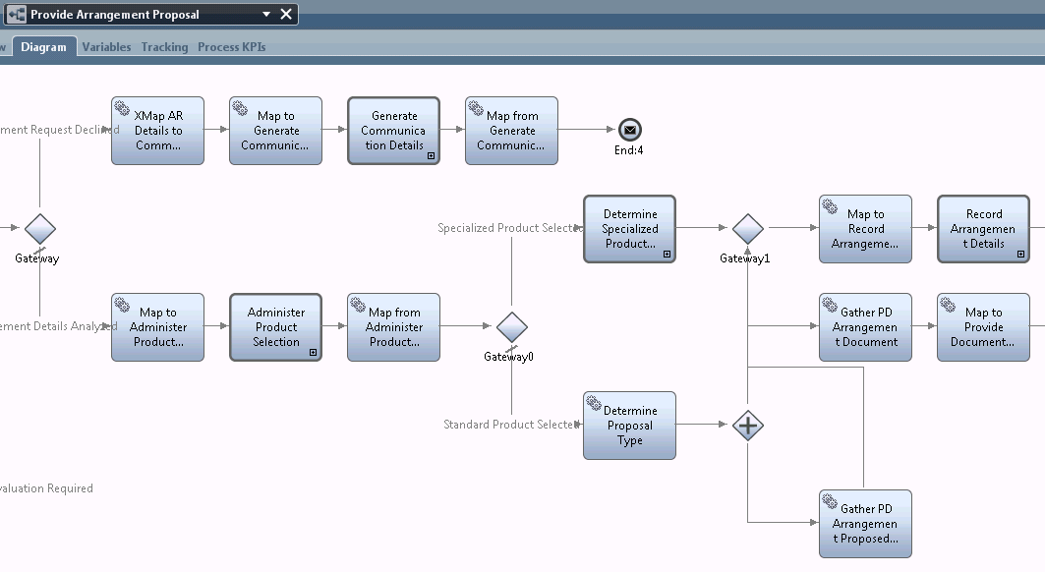
Analysis Process Model (APM)
Analysis
Process
Model
Business
Object
Model
Orchestration
Process
Model
Service
Design
Model
Interface
Design
Model
The Process Models are concerned with the specification of the long running Business Processes that would be customized to an organization’s needs in the context of initiatives such as Business Transformation, Regulatory Alignment or Process Automation.
Analysis Process Model (APM) Provides the initial Business specification of the processes which is used to underpin the initial analysis activities in determining the optimum subset of processes for a Project from a business perspective
Analysis level business processes. Not intended for execution
Candidate service tasks (automatable tasks) linked to from BOM Capability Operations
The structure of APM Item Definitions are defined by and linked to BOM classes
BPS for Standard Tooling

Slide 19
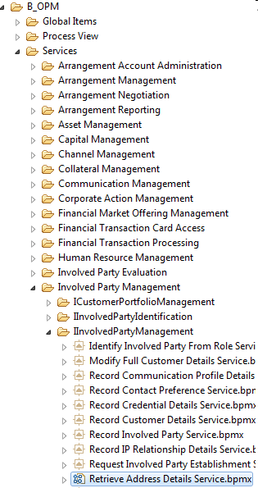
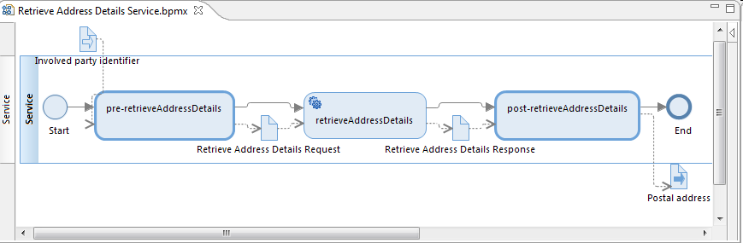
Orchestration Process Model (OPM)
OPM only available with the “off the shelf” tooling option
Analysis
Process
Model
Business
Object
Model
Orchestration
Process
Model
Service
Design
Model
Interface
Design
Model
Provides the design level technical specification of the processes which forms the basis for any downstream implementation of executable processes
Design level business processes - intended for execution
OPM business processes can “orchestrate” complex invocations of Services
Contains equivalent business processes to the APM, but in which candidate service tasks are replaced with ServiceTasks, which invoke Services.
The structure of OPM data artefacts are defined by Service Design Model primitive types, enumerations and Transfer Objects
Data must pass consistently through OPM business processes. Data in OPM business processes must also be consistent with data in Service Messages
BPS for Standard Tooling

Slide 20
Agenda
Learn about the Models and banking content supported
Learn about the model development options
Learn about each of the model components
Learn about how models support a project development lifecycle
Summary

Slide 21
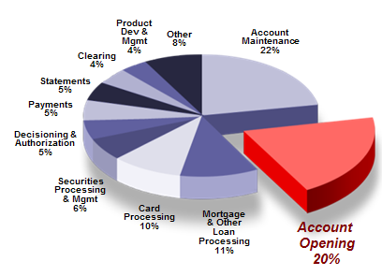
Account Opening – Practical Example
Lack of integration between the channels results in:
  Inconsistent customer experience
  Increased customer abandonment
  Inability to leverage customer data from other channels
  Difficulty in transferring cases and applications
  Increased work effort for introduction of new products
Lack of automation results in:
  Administratively intense processes limits cross-sell and up-sell.
  90% of applications require manual intervention, increasing both cost and time to fund the account.
New Account Opening Costs
  Each year the average regional bank incurs the following costs
  because of there New Account Opening system:
    $2.4 million in increased costs due to manual and duplicate
    process steps
    $11.4 million in lost cross-sell and up-sell revenue due to
    barriers caused by long and inefficient processes
    $4.5 million in lost revenue due to client abandonment
  Account Opening costs are 20% of global banks operating costs
Cost Breakdown of a Bank’s Activity
Total Mfg. & Processing Cost Base

Slide 22
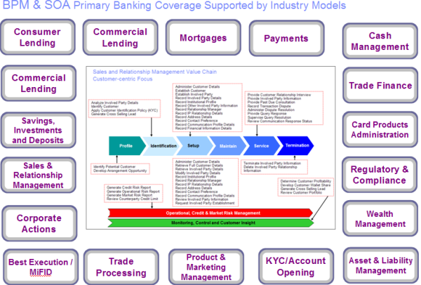
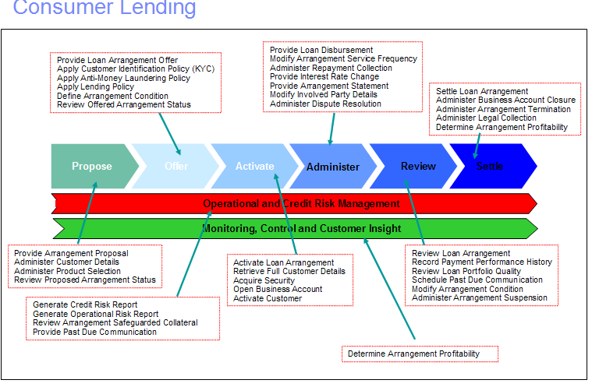
Step 1 – Model Driven Development
Derive a high level understanding of account opening project using value chain analysis
IDENTIFICATION OF PROJECT SCOPE
SCOPING OF BUSINESS PROCESSES
PROCESS ANALYSIS
SERVICE ANALYSIS
SERVICE DESIGN
PROCESS DESIGN
PROCESS IMPLEMENTATION
SERVICE IMPLEMENTATION
Notes:
3

Slide 23
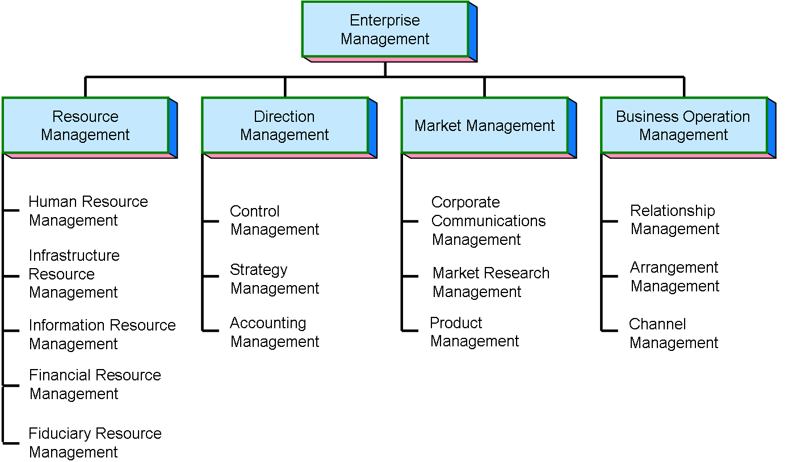
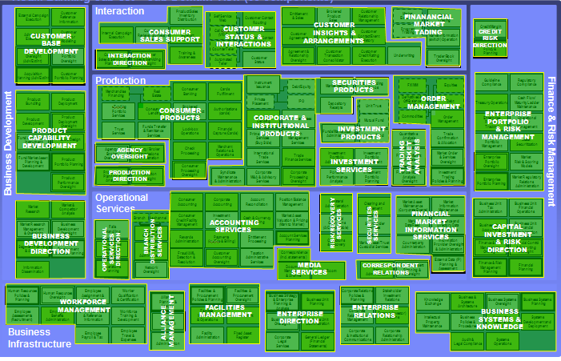
Step 2 – Model Driven Development
Detailed and accurate documentation of project scope using strategic scoping models
STRATEGY
IDENTIFICATION OF PROJECT SCOPE
SCOPING OF BUSINESS PROCESSES
PROCESS ANALYSIS
SERVICE ANALYSIS
SERVICE DESIGN
PROCESS DESIGN
Summary
501 Function Model elements - detailed definitions allowing accurate & efficient scoping
Sample Loan Origination elements are:
  Arrangement Negotiation, Arrangement Qualification, Collateral Management, Arrangement Account Set Up, Customer Evaluation, Customer Limit Application, Financial History Evaluation, Financial Projection Evaluation, Channel Management, …
Summary
202 Universal Banking Components
Covers Retail, Commercial, Private & Investment Banking
PROCESS IMPLEMENTATION
SERVICE IMPLEMENTATION

Slide 24
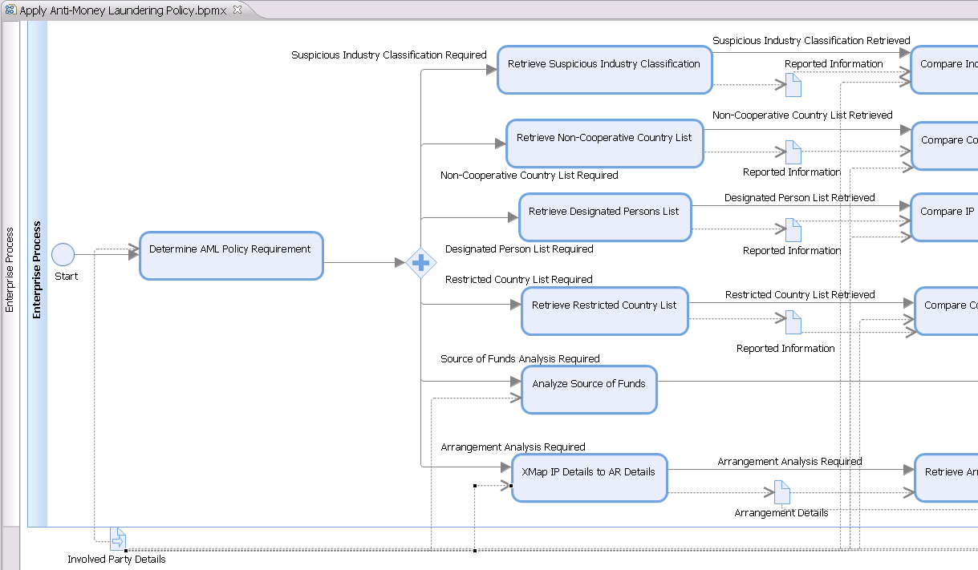
Step 3 – Model Driven Development
Accelerate documentation of optimum business process requirements using Banking Industry Model templates
IDENTIFICATION OF PROJECT SCOPE
Banking Industry Models provide comprehensive BPM templates that are both agile and flexible and accelerate the business re-engineering phase and have been validated across multiple client engagements
SCOPING OF BUSINESS PROCESSES
PROCESS ANALYSIS
SERVICE ANALYSIS
SERVICE DESIGN
PROCESS DESIGN
PROCESS IMPLEMENTATION
SERVICE IMPLEMENTATION

Slide 25
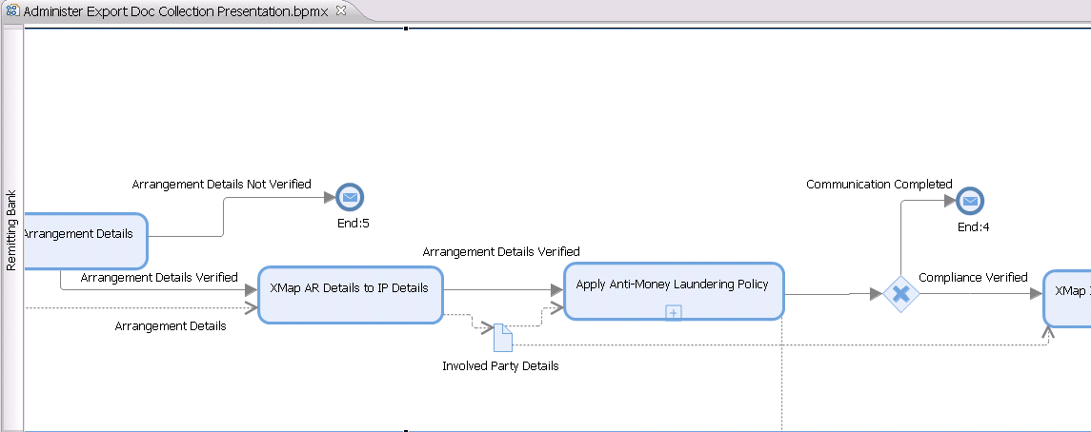
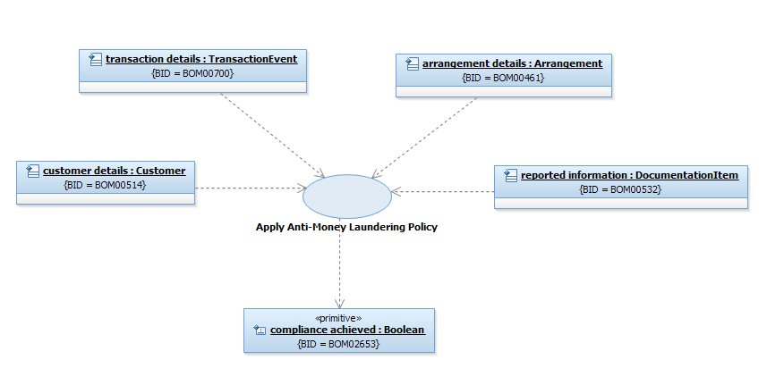
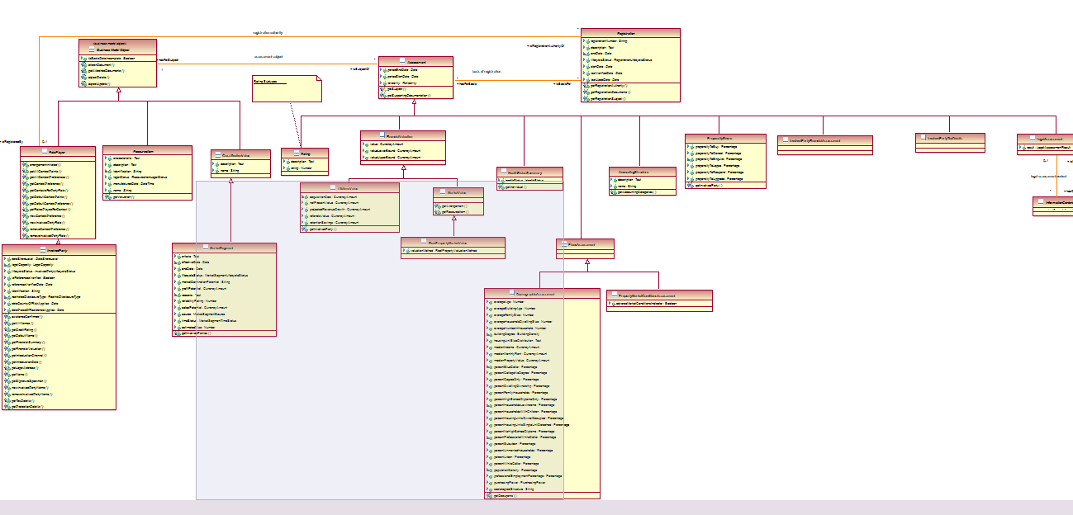
Step 4 – Model Driven Development Example
Clear traceability between automated business process requirements and downstream SOA IT analysis representation using UML methodologies
Apply AML Policy
IDENTIFICATION OF PROJECT SCOPE
SCOPING OF BUSINESS PROCESSES
PROCESS ANALYSIS
SERVICE ANALYSIS
SERVICE DESIGN
PROCESS DESIGN
PROCESS IMPLEMENTATION
SERVICE IMPLEMENTATION
Comprehensive SOA templates that accelerate straight through processing efficiency…

Slide 26

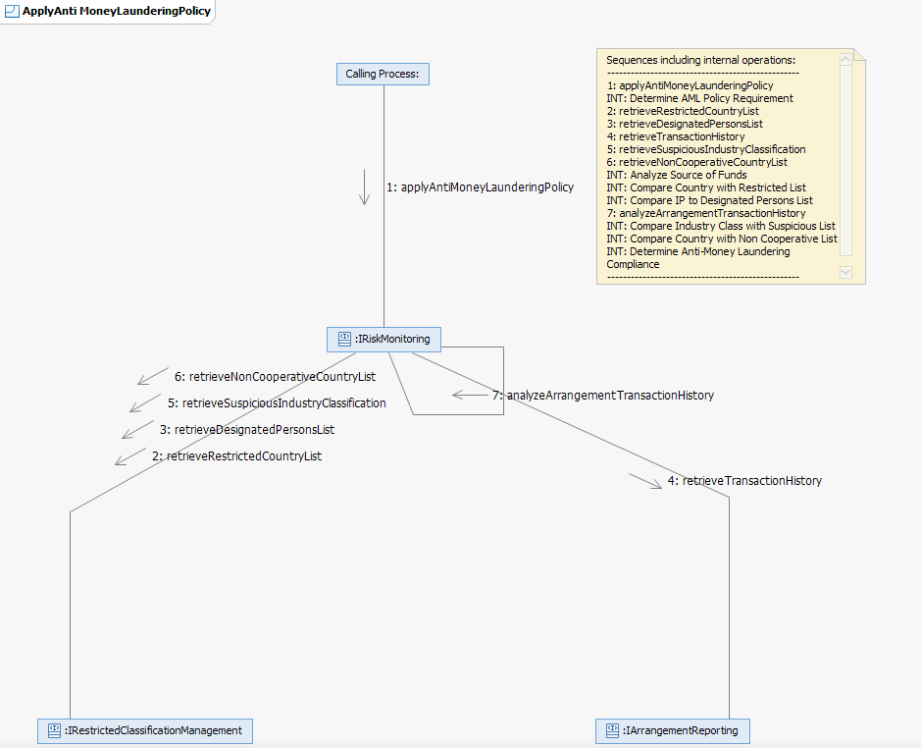
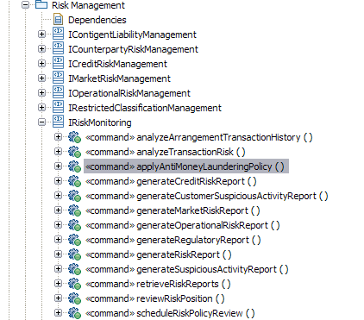
Step 5 – Model Driven Development Example
Clear traceability between automated business process requirements and downstream SOA IT design representation using UML methodologies…
Apply AML Policy
IDENTIFICATION OF PROJECT SCOPE
SCOPING OF BUSINESS PROCESSES
PROCESS ANALYSIS
SERVICE ANALYSIS
SERVICE DESIGN
PROCESS DESIGN
PROCESS IMPLEMENTATION
SERVICE IMPLEMENTATION

